Slide 1


PAL: Provider Access Legislation

Slide 2
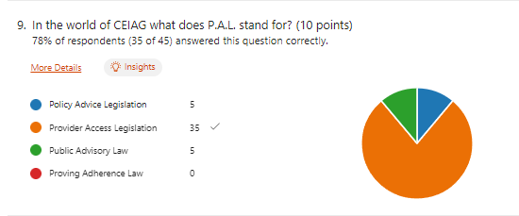

The BIG #NCW2023 BHCS Teaching Staff Careers Quiz!

Slide 3
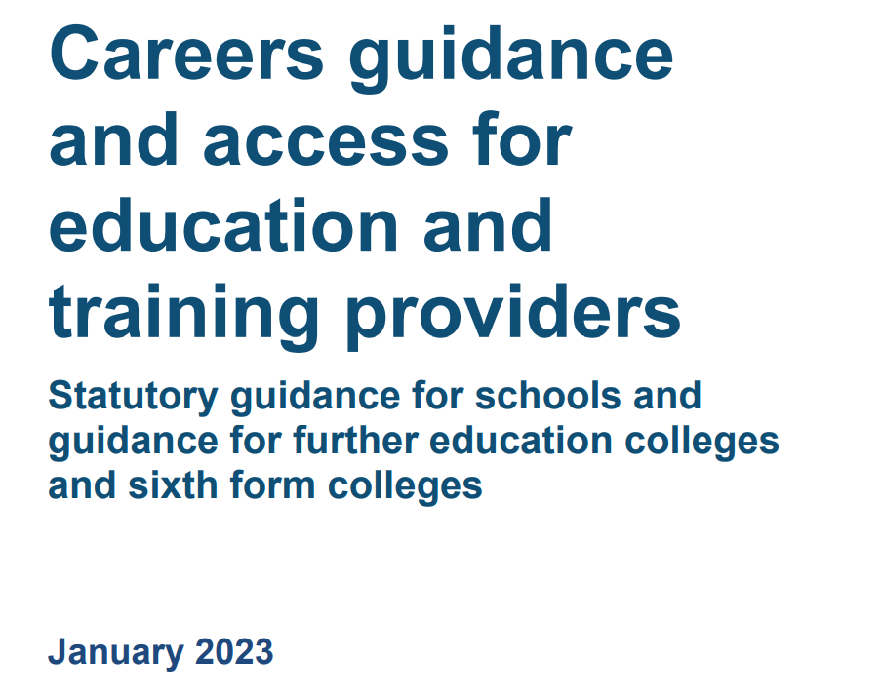
Provider Access Legislation: A statutory duty
Through the Skills and Post-16 Education Act 2022 the DfE strengthened the PAL.
All schools must provide at least 6 encounters for all their pupils during school years 8-13. For us at BHCS that means a minimum, of 4 encounters in total and one in each year from 8 - 11.

Slide 4
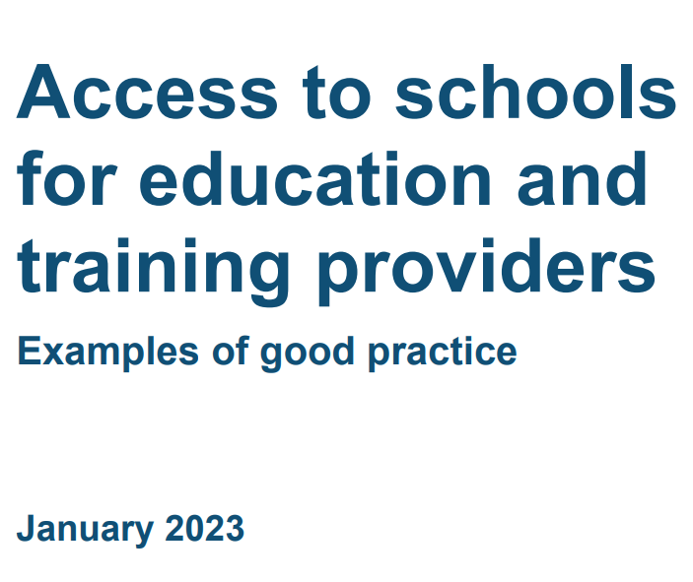
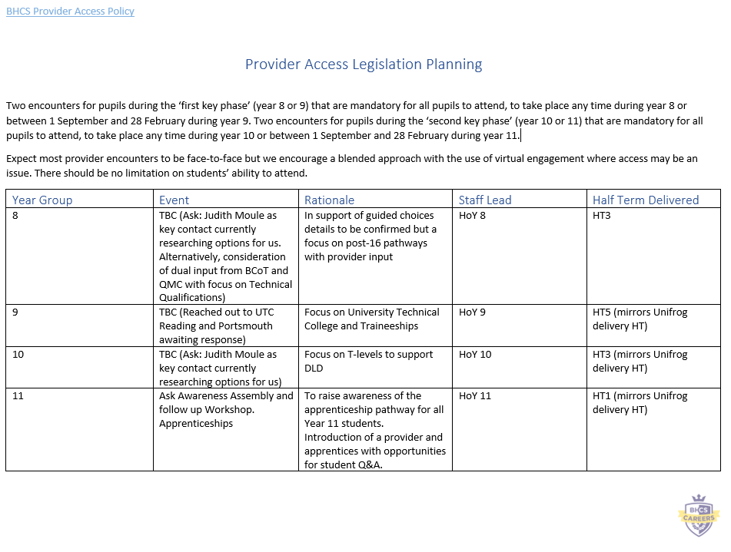
Developing the BHCS PAL offer

Slide 6
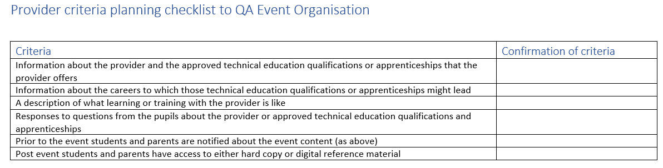
An insight to planning

Slide 7
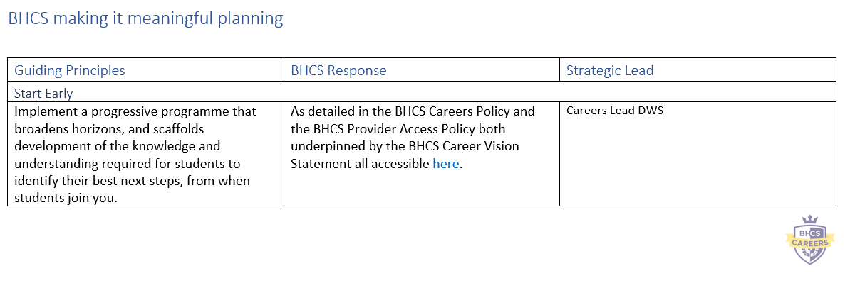
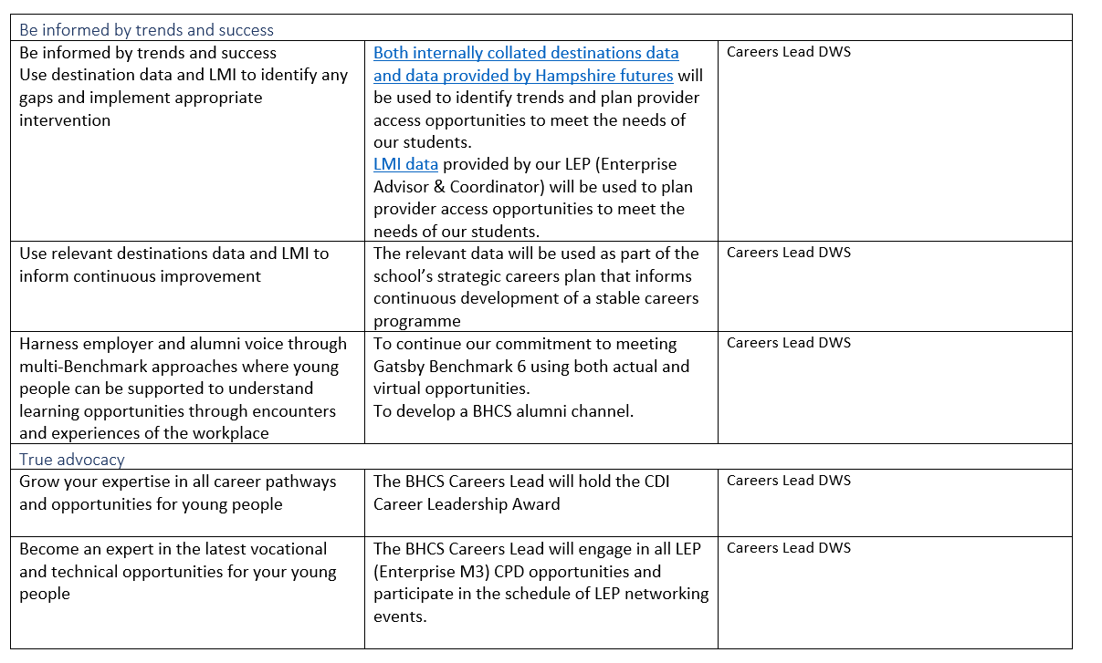
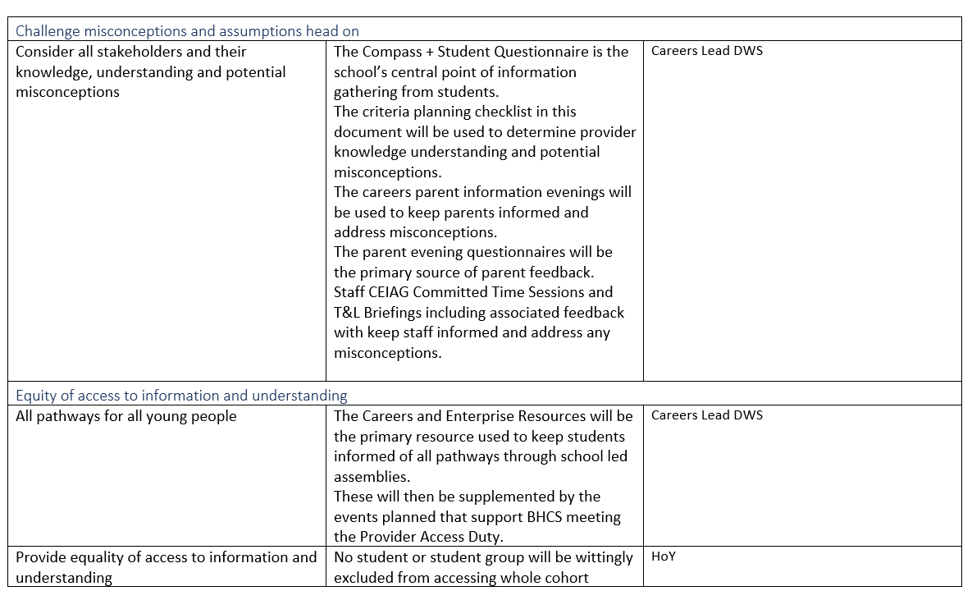
Making it meaningful planning

Slide 8
Thank you for your time.
Brighton Hill Community School
Brighton Way
Basingstoke
Hampshire
RG22 4HS
Phone: 01256 350606
Email: admin@brightonhill.hants.sch.uk

